Slide 1
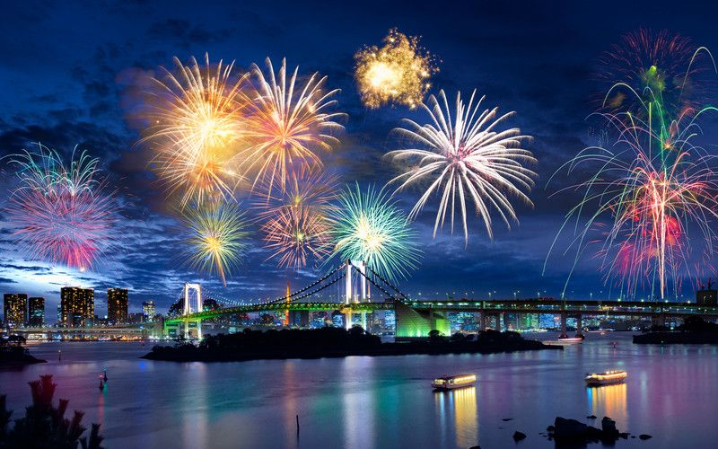
Hanabi
Shay Shwarz
Hodaya Binyamini

Slide 2
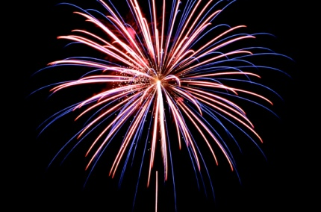
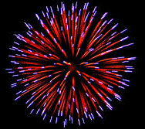
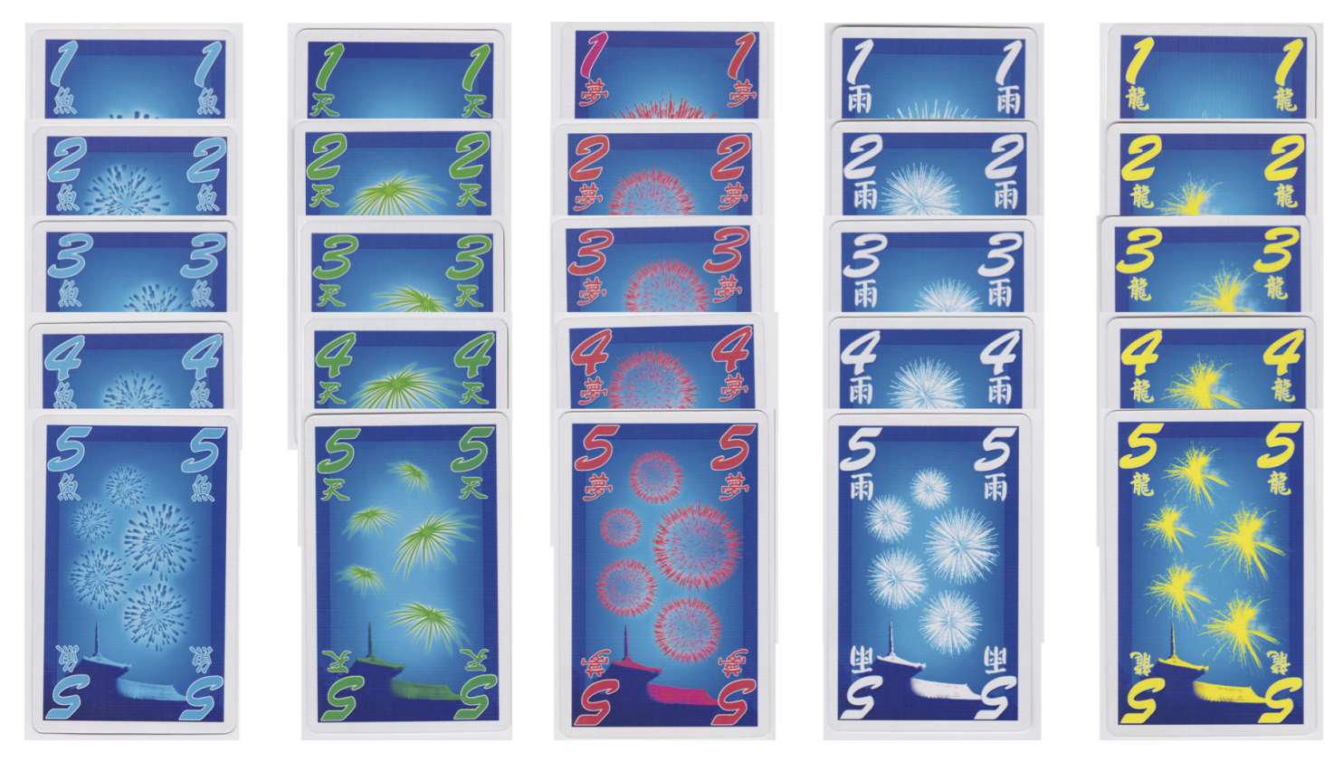
HOW TO PLAY HANABI
The game cards:

Slide 3
HOW TO PLAY HANABI
Players cannot see their own cards but can see the other player’s cards.
The goal of the group is to make series from 1 to 5 in every color.
In each player’s turn, the player can:
spend an information token to tell another player about a feature (color or value) of the cards they have.
2. discard a card from his hand (and get an info token in return)
3. choose to play a card from his hard
When playing a card players must try to play a card which is consecutive to the card in play with the same color.
Failing to play a proper card result in a strike.
3 strikes ends the game.
The group wins if all stacks are complete (corresponding to a score of 25).

Slide 4
PREVIOUS WORKS
Firstly, The hanabi game was proven to be NP-complete (even for cheaters who look at their cards)**.
**Baffier, J. F., Chiu, M. K., Diez, Y., Korman, M., & Mitsou, V. (2016). Hanabi is NP-complete, even for cheaters who look at their cards.‏

Slide 5
PREVIOUS WORKS
Evolving Agents for the Hanabi 2018 CIG Competition**
In this paper:
The author developed a genetic algorithm that builds rule- based agents by determining the best sequence of rules from a fixed rule set to use as strategy.
The author defined 72 rules, every chromosome is permutation of this rules.
They used the operators of swap mutation and ordered crossover.
**Canaan, R., Shen, H., Torrado, R., Togelius, J., Nealen, A., & Menzel, S. (2018, August). Evolving Agents for the Hanabi 2018 CIG Competition. In 2018 IEEE Conference on Computational Intelligence and Games (CIG) (pp. 1-8). IEEE.‏

Slide 6
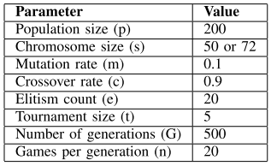
PREVIOUS WORKS
Evolving Agents for the Hanabi 2018 CIG Competition
The parameters:
The average score of this agent:
mirror game: 19.32
mixed agents: 11.65

Slide 7
PREVIOUS WORKS
How to Make the Perfect Fireworks Display: Two Strategies for Hanabi**
In this paper:
A description of Hanabi strategies based on the mathematical “hat guessing game”.
In the first strategy players can recommend moves for other players (as part of a strategy).
The second strategy allows the player to determine the content of his hand.
Strategies are based on network coding.
**Cox, C., De Silva, J., Deorsey, P., Kenter, F. H., Retter, T., & Tobin, J. (2015). How to make the perfect fireworks display: Two strategies for hanabi. Mathematics Magazine, 88(5), 323-336.‏

Slide 8
OUR GOAL
Develop an agent using genetic programming algorithm that can play the Hanabi game.
The model gets the game state: desk cards, discarded cards, players hands, info tokens, etc… the output is the next action the player should take.

Slide 9
SIMULATION
We use the python library deap
Our Parameters for the simulation:
Population Size: 30
The initial individuals are full trees of depth 4-10
Crossover: one point crossover, probability: 0.9
Mutation: uniform mutation - randomly select a point in the tree individual, then replace the subtree at that point, probability: 0.1
Generations: 100
Selection: tournament selection with size 7

Slide 10
FITNESS FUNCTION
The Fitness function is simply running a simulation of a game N times and computing the result of each game (the fitness value is the average result of N games).

Slide 11
FITNESS FUNCTION
Notes:
Pop size = 30
Starter individual depth 4-10
Selection tournament selection with size 7
Cx one point crossover
Mutation
Ngenerations = 100
Cxpb 0.9
Mutpb 0.1

